Slide 1
1. Files
2. XML Parser
3. SQLite
4. Content Provider

Slide 2
Android Files
Uses the same file constructions found in a typical Java application
Files can be stored in the device’s (small) main memory or in the much larger SD card.
Files stored in the device’s memory, stay together with other application’s resources (such as icons, pictures, music,… ). We will call this type: Resource Files.

Slide 3
Data storage options
Shared Preferences Store private primitive (nguyên thuỷ) data in key-value pairs.
Internal Storage Store private data on the device’s memory.
External Storage Store public data on the shared external storage.
SQLite Databases Store structured data in a private/public database.
Network Connection Store data on the web with your own network server.

Slide 4
1. Files
1.1 Internal Storage
1.2 External Storage
1.3 Saving Cache files

Slide 5
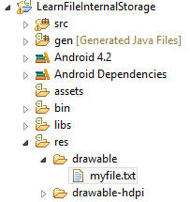
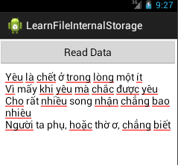
1.1 Internal Storage
Reading Resource File : Everything in the apk will be read only..

Slide 6
1.1 Internal Storage
<LinearLayout xmlns:android="http://schemas.android.com/apk/res/android"
xmlns:tools="http://schemas.android.com/tools"
android:id="@+id/LinearLayout1"
android:layout_width="match_parent"
android:layout_height="match_parent"
android:orientation="vertical"
tools:context=".MainActivity" >
<Button
android:id="@+id/btnreaddata"
android:layout_width="match_parent"
android:layout_height="wrap_content"
android:text="Read Data" />
<EditText
android:id="@+id/editdata"
android:layout_width="match_parent"
android:layout_height="0dip"
android:layout_weight="2"
android:ems="10"
android:gravity="top|left"
android:inputType="textMultiLine" >
<requestFocus />
</EditText>

Slide 7
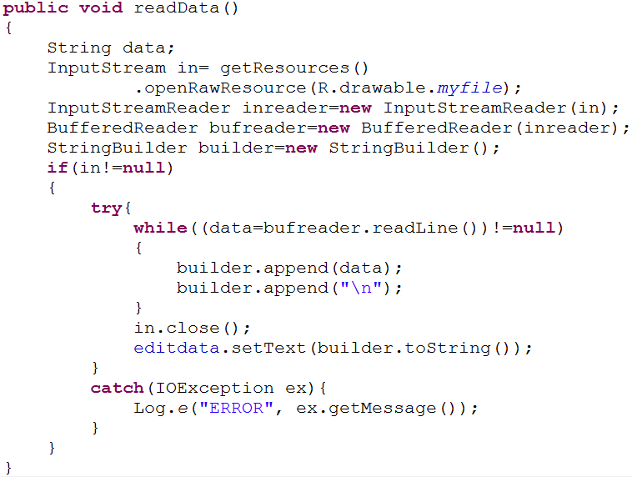
1.1 Internal Storage
Reading Resource File

Slide 8
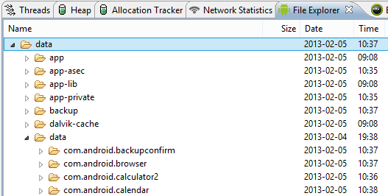

1.1 Internal Storage
If you want to Read and Write an internal file:
File is stored in the phone’s memory under:
/data/data/app/files
Android app name

Slide 9
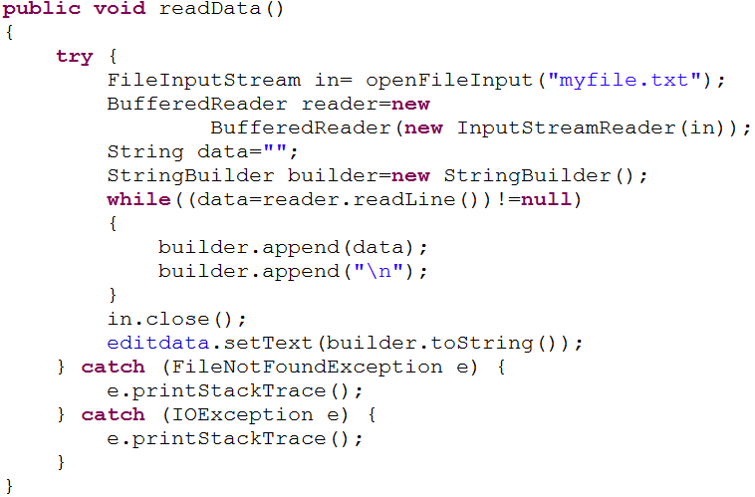
1.1 Internal Storage
Reading an internal File

Slide 10
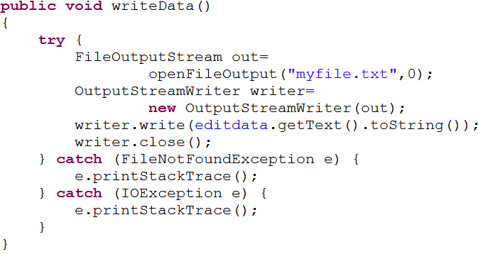
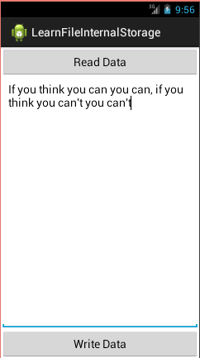
1.1 Internal Storage
Writing an internal File

Slide 11
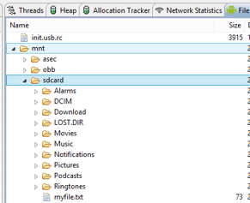
1.2 External Storage
Reading/Writing to External Device’s SD card. SD card has the obvious advantage of a larger working space.

Slide 12
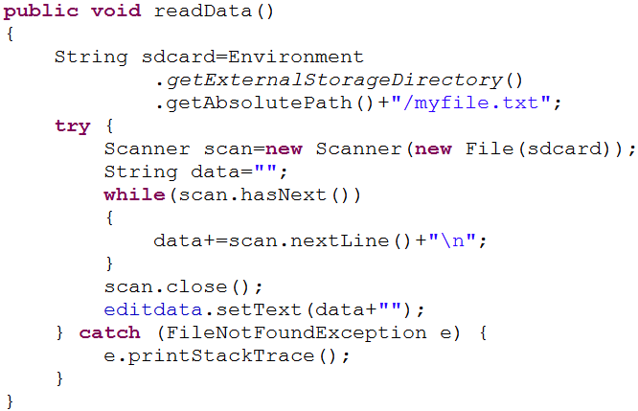
1.2 External Storage
Reading

Slide 13
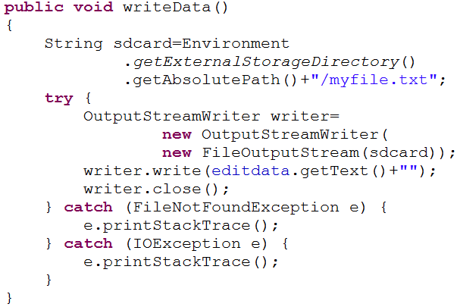
1.2 External Storage
Writing

Slide 14
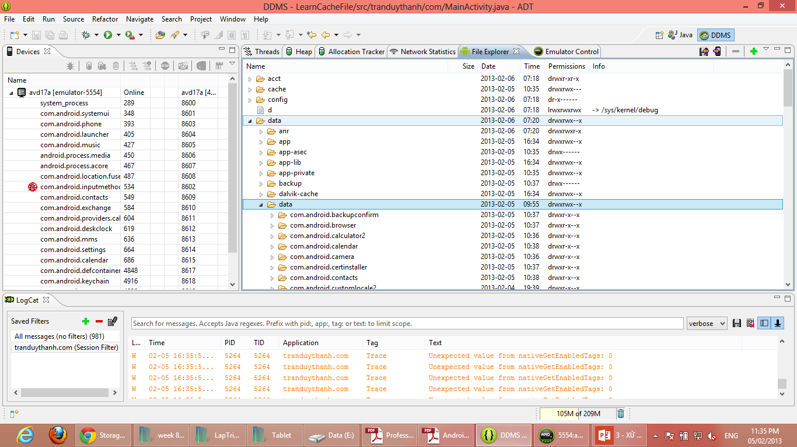
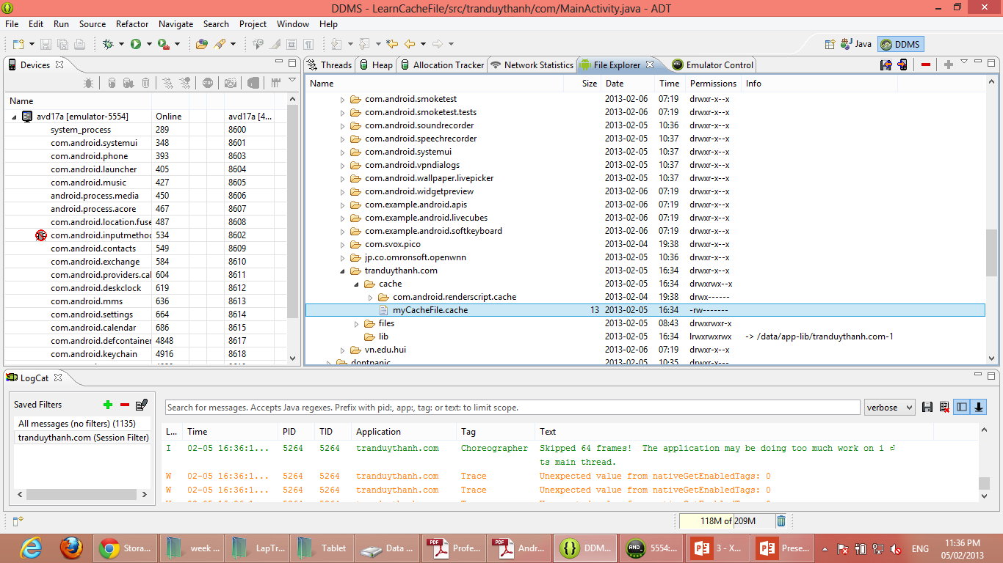
1.3 Saving Cache files
To speed up your application’s performance and how often it accesses the network➔create a cache file.
Cache files are stored in the following location on the Android file system:
/data/data/app/cache
Click icon to pull or push file

Slide 15
1.3 Saving Cache files
If you'd like to cache some data, rather than store it persistently, you should use getCacheDir() to open a File that represents the internal directory where your application should save temporary cache files.
When the device is low on internal storage space, Android may delete these cache files to recover space.
However, you should not rely on the system to clean up these files for you. You should always maintain the cache files yourself and stay within a reasonable limit of space such as 1MB.
When the user uninstalls your application, these files are removed.

Slide 16
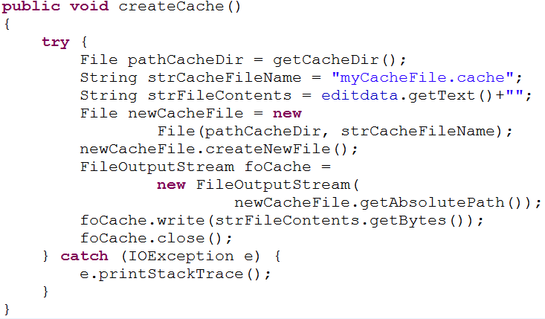
1.3 Saving Cache files
Creating cache file

Slide 17
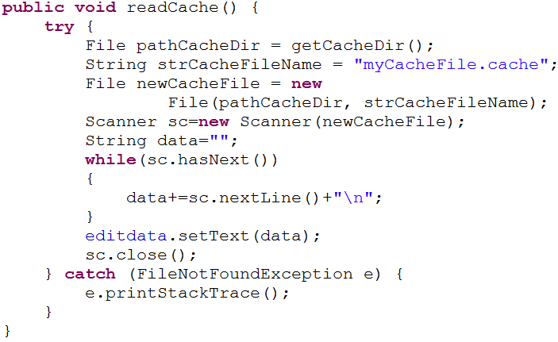
1.3 Saving Cache files
Reading cache file

Slide 18
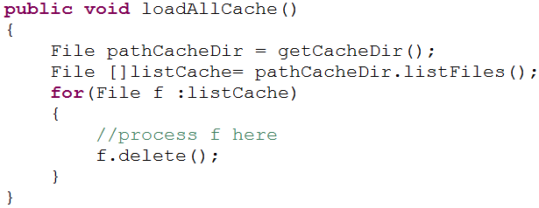
1.3 Saving Cache files
Get all cache files

Slide 19
2. XML Parser
2.1 What’s XML?
2.2 How is XML used?
2.3 Parsing XML by DOM
2.4 Parsing XML by SAX

Slide 20
2.1 What’s XML?
Extensible Markup Language (XML) is a set of rules for encoding documents in a readable form.
Similar to HTML but <tagElements> are user-defined.
It is defined in the XML Specification produced by the W3C.
XML's design goals emphasize transparency, simplicity, and transportability over the Internet.
Example of XML-based languages include: RSS , SOAP, and XHTML.

Slide 21
2.2 How is XML used?
XML is used for defining and documenting object classes.
For example, an XML document (.xml) might contain a collection of complex employee elements, such as <employee id=“…” title=“…” >...</employee> which lexically includes an “id” and “title” attributes.
Employee may also hold other inner elements such as “name”, “country”, “city”, and “zip”.
An XML-Data schema (.xsd) can describe such syntax.

Slide 22
2.2 How is XML used?

Slide 23
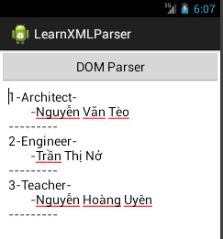
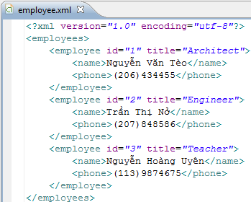
2.3 Parsing XML by DOM
DOM : W3C DocumentBuilder Parser
Document Object Model
Cache all
Standard tree structure
Parsing this XML

Slide 24
2.3 Parsing XML by DOM
The XML file is given to the W3C parser to construct an equivalent tree.
Elements from the XML file are represented in the parse-tree as NodeLists. These ArrayList-like collections are made with the .getElementsByTagName() method.
An individual node from a NodeList could be explored using the methods:
.item(i), .getName() , .getValue() , .getFirstChild() , .getAttributes(),…

Slide 25

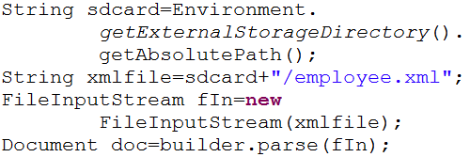
2.3 Parsing XML by DOM
Creating a Java DOM XML parser is done using the javax.xml.parsers.DocumentBuilderFactory class.
Parsing an XML file into a DOM tree

Slide 26
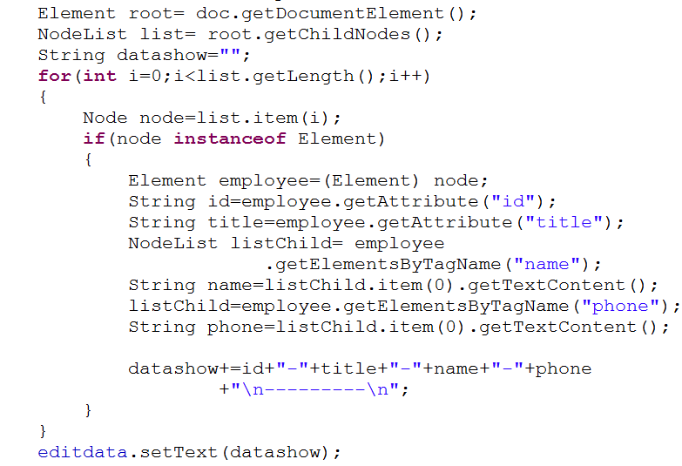
2.3 Parsing XML by DOM

Slide 27
2.3 Parsing XML by DOM
The two most commonly used features of DOM are:
Accessing Child Elements of an Element
Accessing Attributes of an Element
At the top is the Document object. The Document object has a single root element
Element root = doc.getDocumentElement();
get the children of an element
get the attribute of an element
get the data of an element
element.getTextContent();

Slide 28
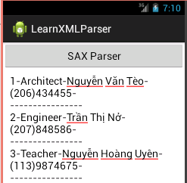
2.4 Parsing XML by SAX
SAX
Simple API for XML
scan the document
Less memory
Faster
Complex
Parsing this XML

Slide 29
2.4 Parsing XML by SAX
SAX
XmlPullParser is used to scan the document using the .next() method and detect the main eventTypes START_TAG
TEXT
END_TAG
END_DOCUMENT
When the beginning of a tag is recognized, we use the .getName() method to get the tag name.
We use the method .getText() to get the data after TEXT event.

Slide 30
2.4 Parsing XML by SAX
Attributes from an element can be extracted using the methods:
.getAttributeCount()
.getAttributeName()
.getAttributeValue()

Slide 31
2.4 Parsing XML by SAX
Using the XmlPullParser class to generate scanner/parser to traverse an XML document

Slide 32
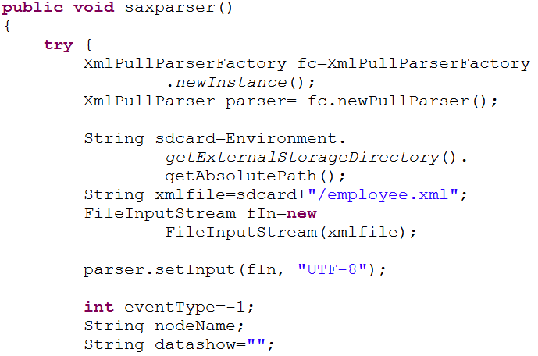
2.4 Parsing XML by SAX

Slide 33
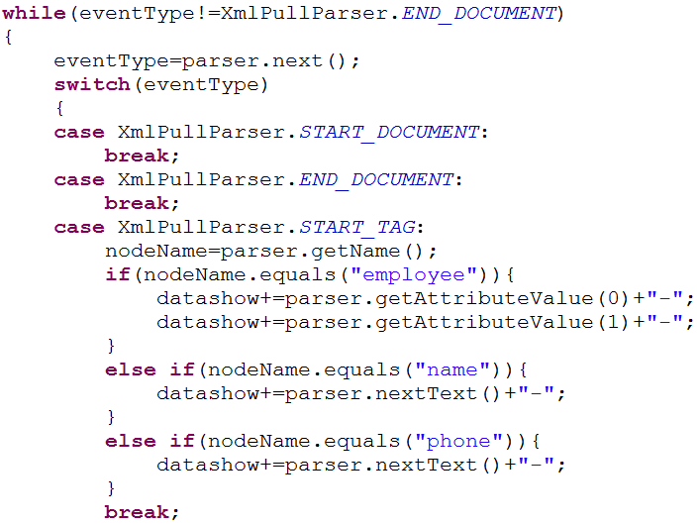
2.4 Parsing XML by SAX

Slide 34
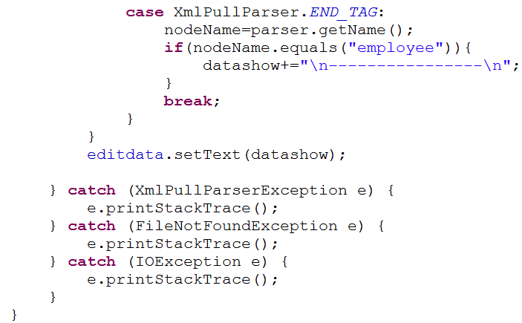
2.4 Parsing XML by SAX

Slide 35
Discussion
Differences between DOM and SAX
(Prepare about 10 minutes then present
some opinion.)
One table using paper writting some opinion

Slide 36
Discussion
Formating
Student_Id - FullName
-
-
-
-

Slide 37
3. SQLite
3.1 Introduction
3.2 Creating Database
3.3 Creating Table
3.4 Action Query:Insert, Update, Delete
3.5 Querying SQLite
3.6 Simple Database Demo

Slide 38
3.1 Introduction
Embedded standalone program called sqlite3
1.SQLite implements most of the SQL-92 standard for SQL.
2.support for triggers and allows most complex queries.
3.SQLITE “does not” implement referential integrity constraints through the foreign key constraint model.
4.In SQLite, It is possible to insert a string into numeric column and so on.

Slide 39
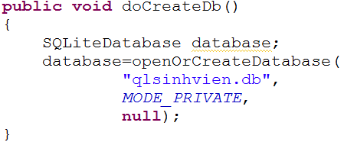

3.2 Creating Database
The simplest way to create a new SQLiteDatabase instance for your application is to use the openOrCreateDatabase() method of your application Context
import android.database.sqlite.SQLiteDatabase;

Slide 40
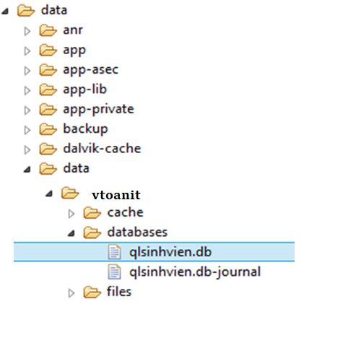
3.2 Creating Database
Storing Database directory:
/data/data/app/databases/<databasename>
So, in this case, the path to the database would be:

Slide 41
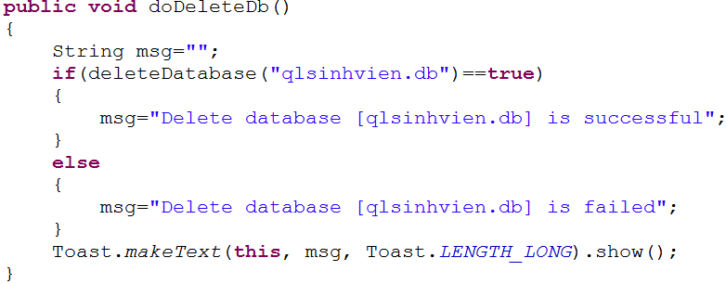
3.2 Creating Database
Beware of sharing issues. You cannot access internal
databases belonging to other people (instead use Content
Providers or external SD Card).
A sentences database requires the Manifest to include:
<uses-permission
android:name="android.permission.WRITE_EXTERNAL_STORAGE" />

Slide 42
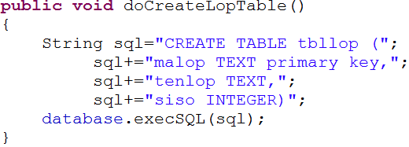
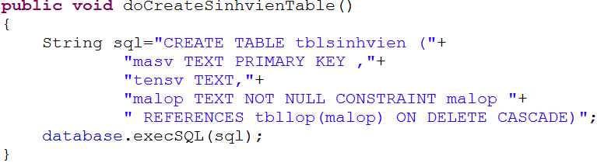
3.3 Creating Table

Slide 43
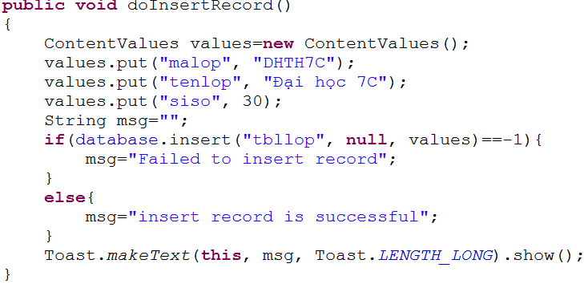
3.4 Action Query:Insert, Update, Delete
Inserting Records:
We use the insert() method to add new data to our tables. We use the ContentValues object to pair the column names to the column values for the record we want to insert.

Slide 44
3.4 Action Query:Insert, Update, Delete
Updating Records:
You can modify records in the database using the update() method.The update() method takes four arguments:
The Table to update records
A ContentValues object with the modified fields to update
An optional WHERE clause, in which ? identifies a WHERE clause argument
An array of WHERE clause arguments, each of which is substituted in place of the ? from the second parameter
public int update (String table, ContentValues values,
String whereClause, String[] whereArgs)
This method Returns the number of rows affected

Slide 45
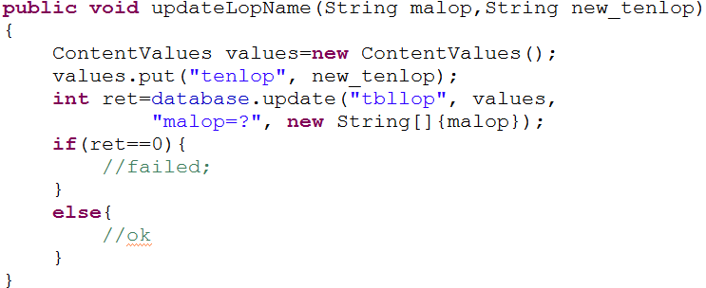
3.4 Action Query:Insert, Update, Delete
Updating Records:
Because we are not updating the other fields, we do not need to include them in the ContentValues object.We include only the tenlop field because it is the only field we change.

Slide 46
4.4 Action Query:Insert, Update, Delete
Deleting Records:
You can remove records from the database using the remove() method.The remove() method takes 3 arguments:
The Table to delete the record from
An optional WHERE clause, in which ? identifies a WHERE clause argument
An array of WHERE clause arguments, each of which is substituted in place of the ? from the second parameter
Passing null to the WHERE clause deletes all records in the table.
public int delete (String table,
String whereClause,
String[] whereArgs)
This method Returns the number of rows affected

Slide 47

3.4 Action Query:Insert, Update, Delete
Deleting Records:
Delete all rows in table tblop:
Delete row with malop=“dhth7c”:
delete method will return the number of rows affected

Slide 48
3.5 Querying SQLite
When results are returned from a SQL query, you often access them using a Cursor found in the android.database.Cursor class. Cursor objects are like file pointers; they allow random access to query results.
public Cursor query (String table, String[] columns, String selection, String[] selectionArgs, String groupBy, String having, String orderBy)

Slide 49
3.5 Querying SQLite
table | The table name to compile the query against.
columns | A list of which columns to return. Passing null will return all columns
selection | A filter declaring which rows to return, formatted as an SQL WHERE clause (excluding the WHERE itself). Passing null will return all rows for the given table.
selectionArgs | You may include ? in selection, which will be replaced by the values from selectionArgs, in order that they appear in the selection. The values will be bound as Strings.
groupBy | A filter declaring how to group rows, formatted as an SQL GROUP BY clause (excluding the GROUP BY itself). Passing null will cause the rows to not be grouped.
having | A filter declare which row groups to include in the cursor, if row grouping is being used, formatted as an SQL HAVING clause (excluding the HAVING itself). Passing null will cause all row groups to be included, and is required when row grouping is not being used.
orderBy | How to order the rows, formatted as an SQL ORDER BY clause (excluding the ORDER BY itself). Passing null will use the default sort order, which may be unordered.

Slide 50
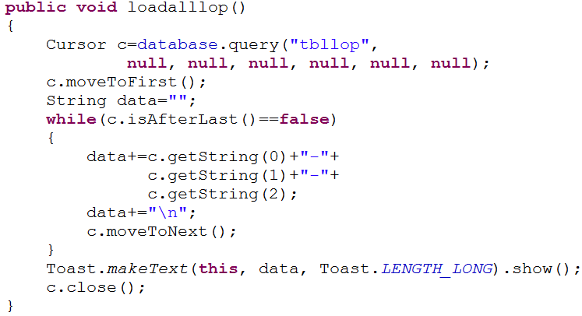
3.5 Querying SQLite

Slide 51
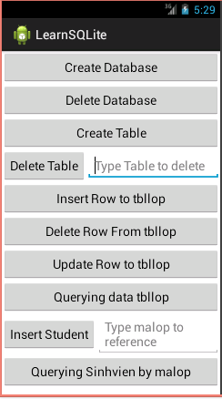
3.6 Simple Database Demo
Transaction→take yourself
SQLiteOpenHelper→take yourself

Slide 52
5. Content Provider
5.1 Introduction
5.2 Using common Content Provider
5.3 Example Using Content Provider

Slide 53
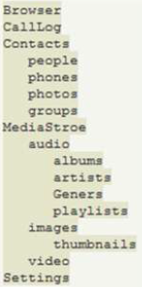
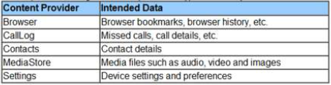
5.1 Introduction
Content provider is a specialized type of data store that exposes standardized ways to retrieve and manipulate the stored data.
You wish to share data between applications, you need to use the content provider model as recommended in Android.
most useful built-in content providers

Slide 54
5.2 Using common Content Provider
To query a content provider, you provide a query string in the form of a URI, with an optional specifier for a particular row, using the following syntax:
<standard_prefix>://<authority>/<data_path>/<id>
For example, to retrieve all the bookmarks stored by your web browsers (in Android), you would use the following content URI:
content://browser/bookmarks
To retrieve all the contacts stored by the Contacts application, the URI would look like this:
content://contacts/people
To retrieve a particular contact, you can specify the URI with a specific ID:
content://contacts/people/3

Slide 55
5.2 Using common Content Provider
Retrieves a managed cursor
CursorLoader loader=new
CursorLoader(context, uri, null, null, null, null);
Cursor c=loader.loadInBackground();
Is equivalent to:
Cursor c = getContentResolver()
.query(uri, null, null, null, null);
getContentResolver() method returns a ContentResolver object, which helps to resolve a content URI with the appropriate content provider
Parametres: URI, projection, SQLWHERE, ORDERBY

Slide 56
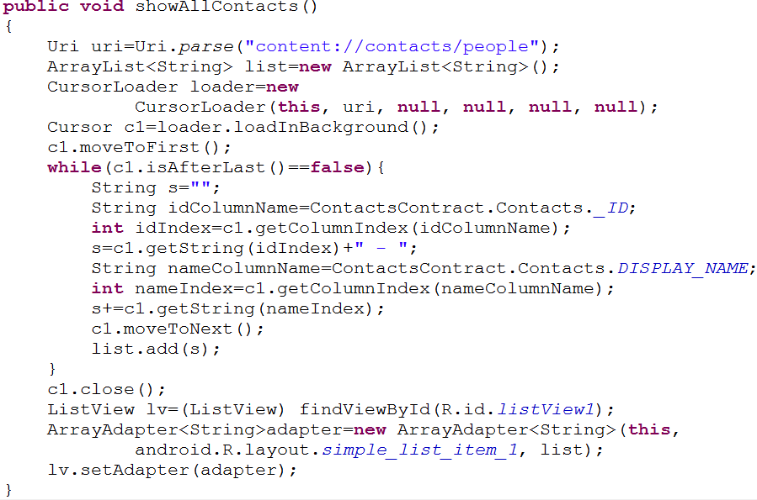
5.2 Using common Content Provider
Get contacts:

Slide 57

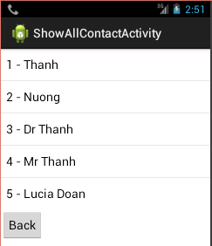
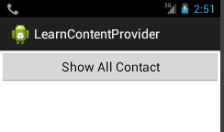

5.2 Using common Content Provider
Get contacts:
Or using getContentResolver instead CursorLoader:

Slide 58
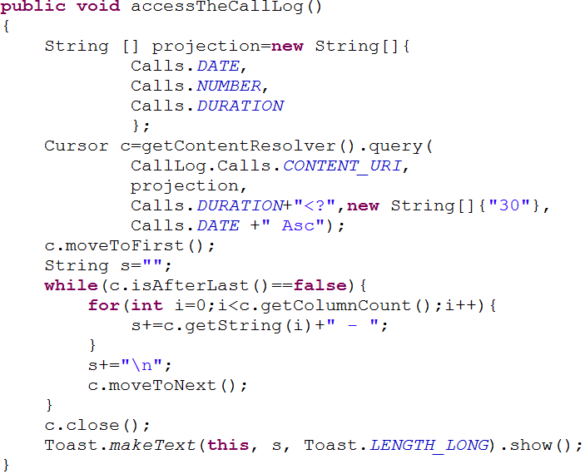
5.2 Using common Content Provider
Access Call Log:

Slide 59
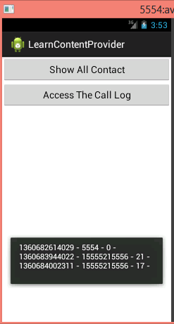

5.2 Using common Content Provider
Access Call Log:
Similar the Contact, you could use CursorLoader class to access the call log

Slide 60
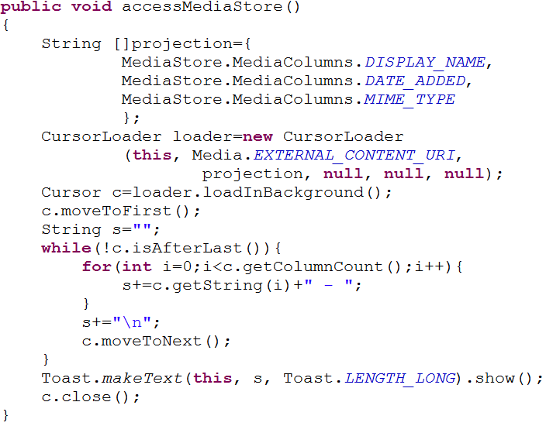
5.2 Using common Content Provider
Access Media Store:

Slide 61
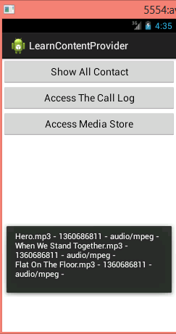

5.2 Using common Content Provider
Access Media Store:
Similar another provider, you could use getContentResolver to access the Media

Slide 62
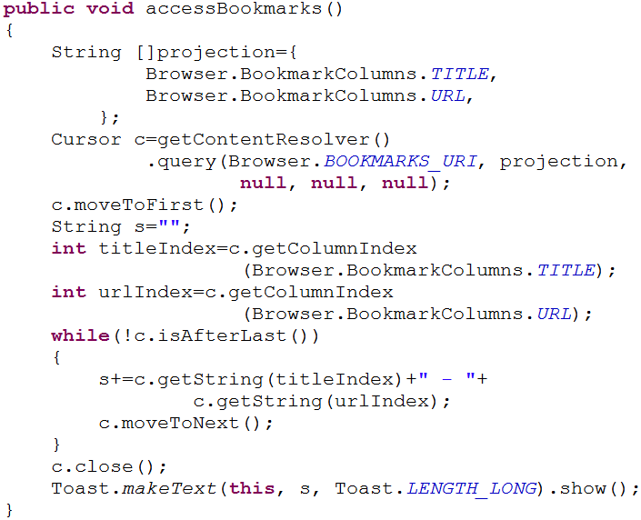
5.2 Using common Content Provider
Access Book mark:

Slide 63
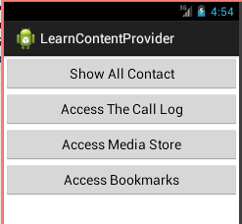
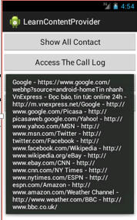

5.2 Using common Content Provider
Access Book mark:

Slide 64


END

